Slide 1

CS302 Design and Analysis of Algorithms
Muhammad sohail afzal

Slide 2
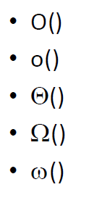
Asymptotic Notations
Mathematical way of representing time complexity of algorithms
Asymptotic – refers to study of function f as n approaches infinity
We use following asymptotic notations :

Slide 3
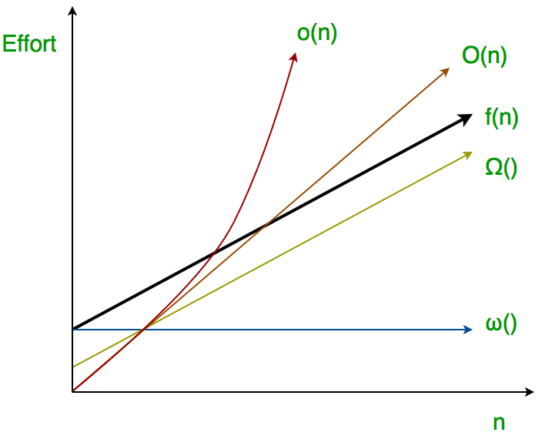
Asymptotic Notations
Big O (Worst case time, tight upper bound, at most amount of time)
Small o (loose upper bound, rough estimate of order of growth)
Big Theta (average time, both upper bound and lower bound, at most and at least time)
Big Omega (best case time, tight lower bound, at least amount of time)
Small Omega (loose lower bound, rough estimate of order of growth)

Slide 4
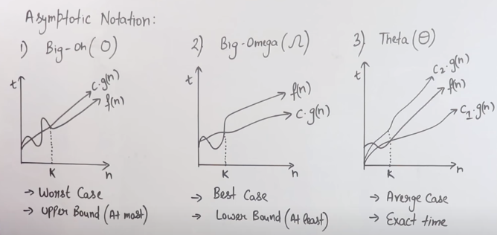
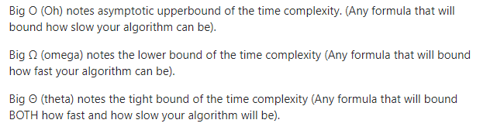
Big O, Big Omega, Big Theta

Slide 5
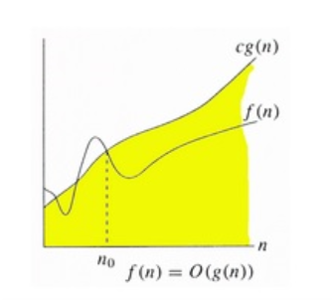
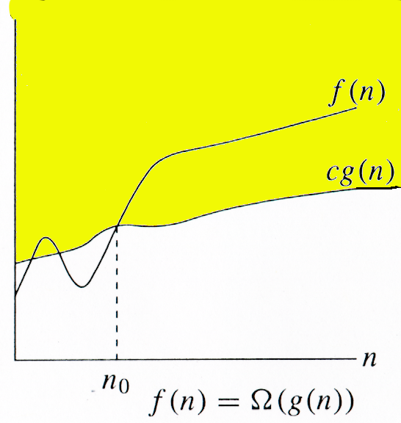
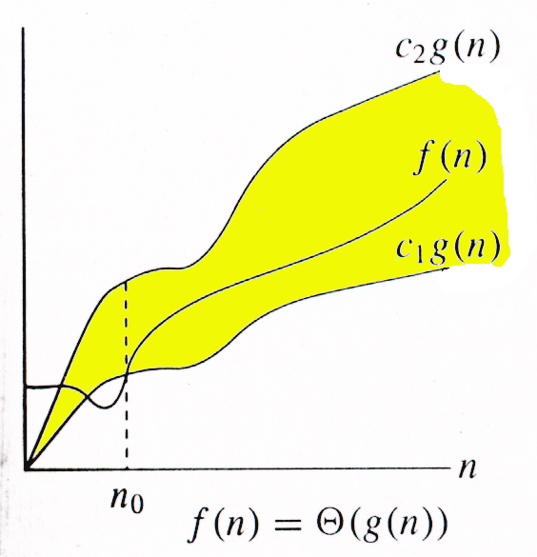
Big O, Big Omega, Big Theta

Slide 6
Example : Development of Notation for Big O
Not concerned with small values of n
Concerned with VERY LARGE values of n
Example: f(n) = n²+4n + 20
n² is the dominant term and the term 4n + 20 becomes insignificant as n grows larger

Slide 7
Example : Development of Notation for Big O
Drop insignificant terms and constants
Say function is of O(n²) called Big-O of n²
Common Big-O functions in algorithm analysis
g(n) = 1 (growth is constant)
g(n) = log ₂ n (growth is logarithmic)
g(n) = n (growth is linear)
g(n) = n log ₂ n (growth is faster than linear)
g(n) = n² (growth is quadratic)
g(n) = 2^{n} (growth is exponential)

Slide 8
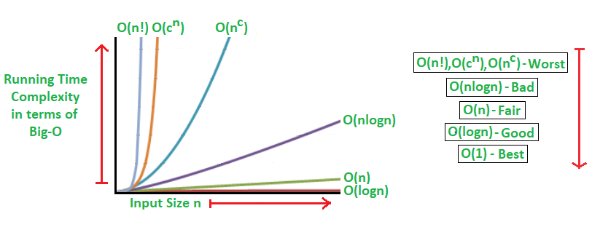
Example :Common Big O functions growth

Slide 9
Example : Common Big O functions growth
n | log2n | nlog2n | n^2 | 2^n
1 | 0 | 0 | 1 | 2
2 | 1 | 2 | 4 | 4
4 | 2 | 8 | 16 | 16
8 | 3 | 24 | 64 | 256
16 | 4 | 64 | 256 | 65536
32 | 5 | 160 | 1024 | 4294967296

Slide 10
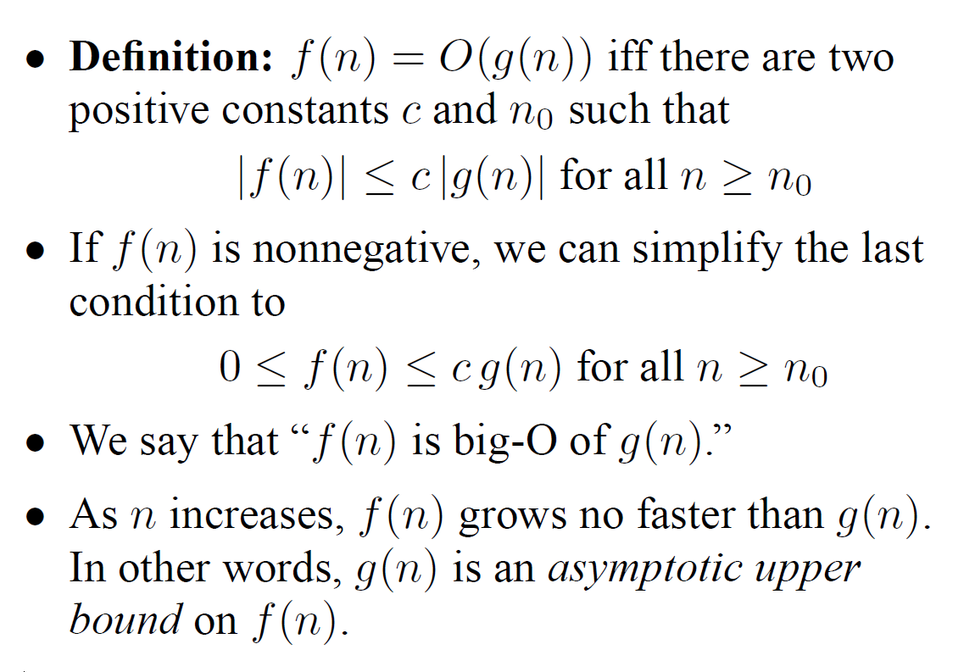
Big O or Big Oh

Slide 11
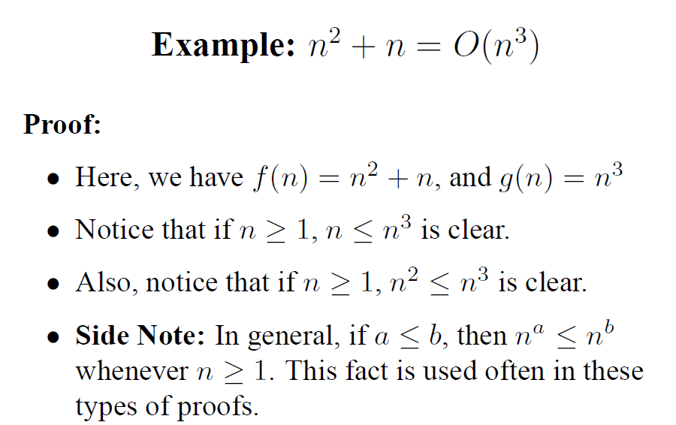

Slide 12
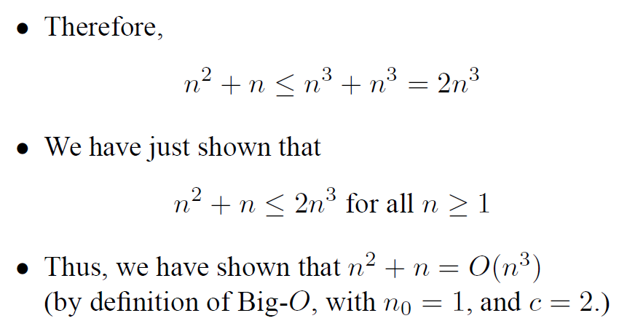

Slide 13
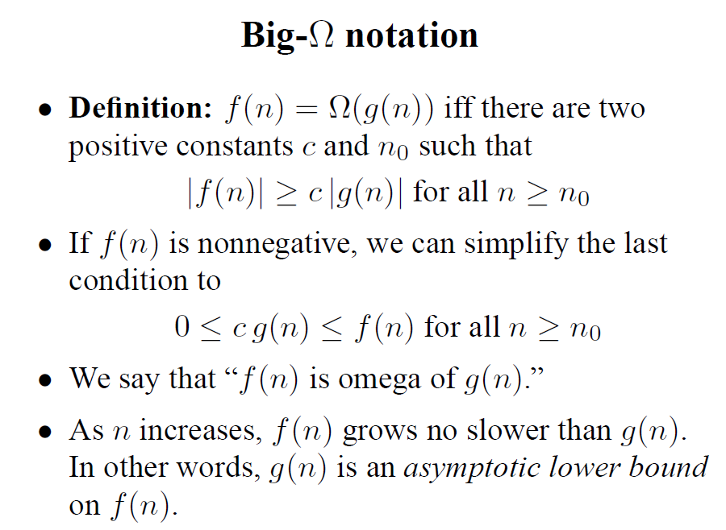
Big Omega

Slide 14
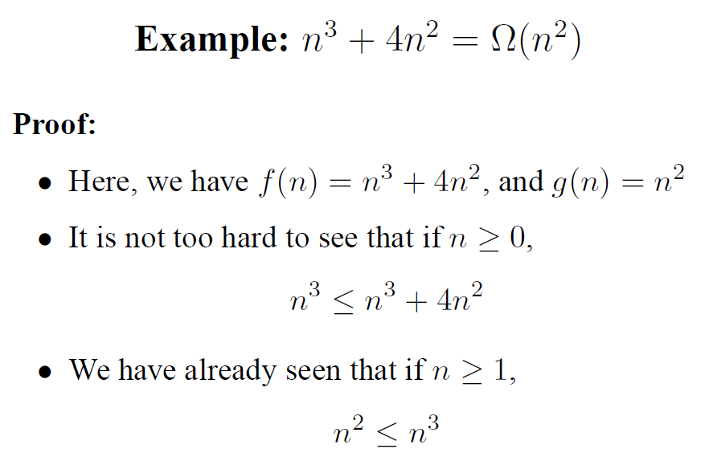

Slide 15
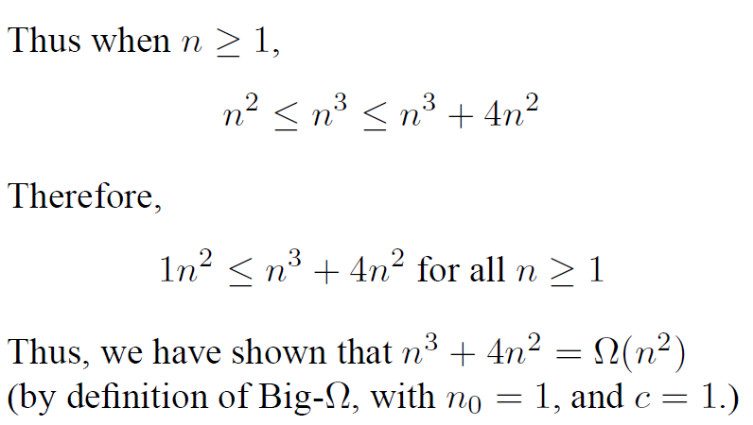

Slide 16
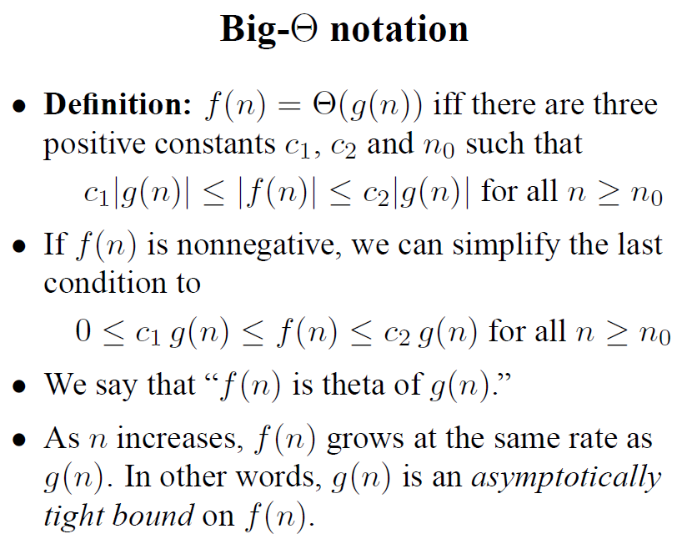
Big Theta

Slide 17
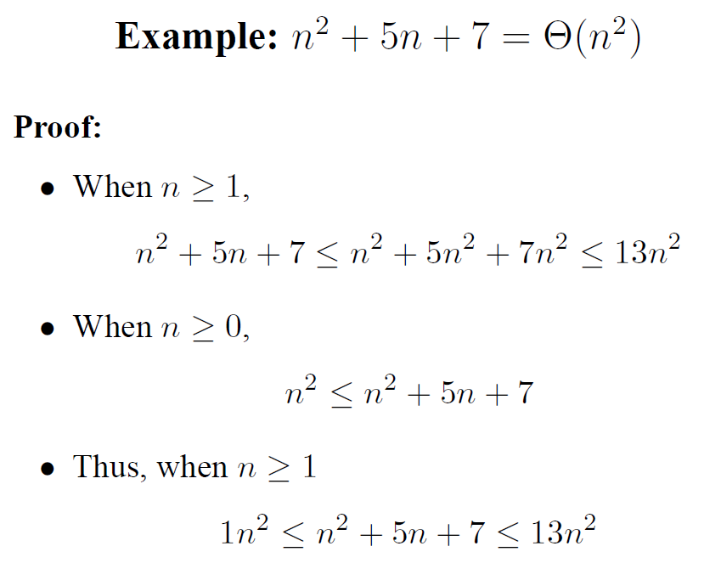
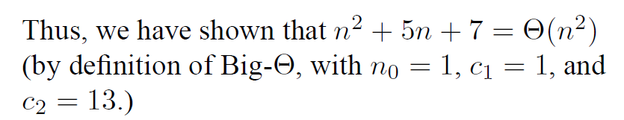

Slide 18
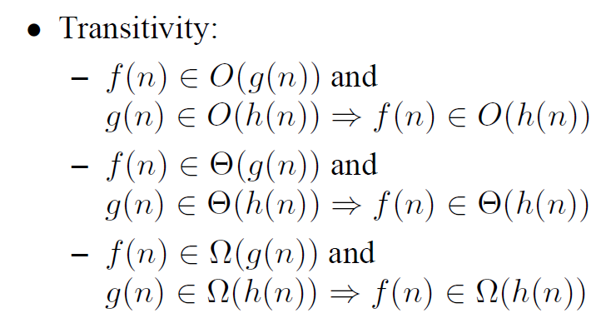

Slide 19
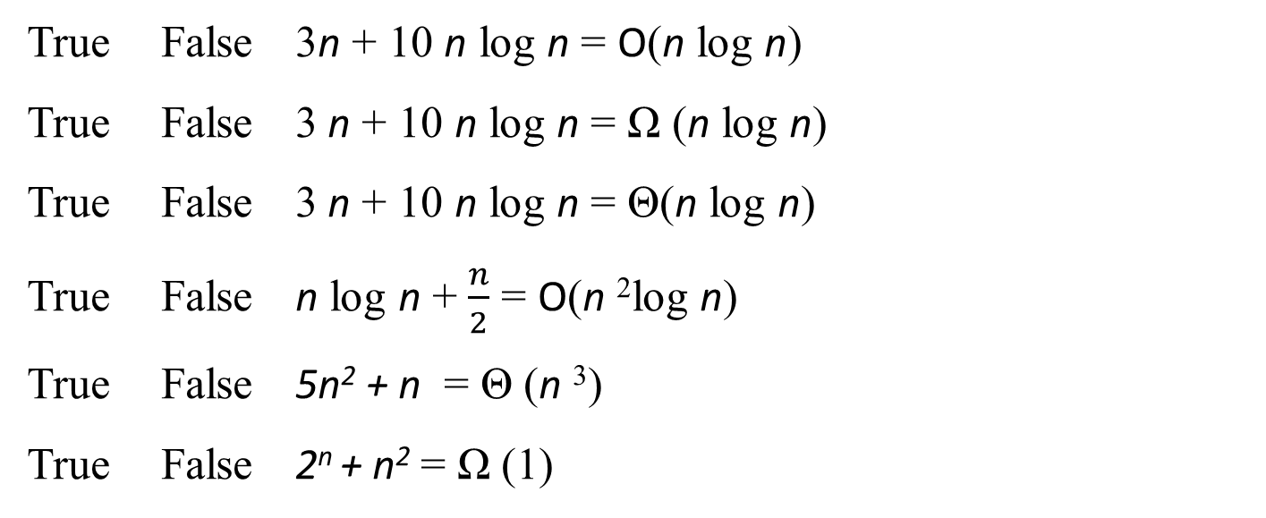
Task 1 for you

Slide 20

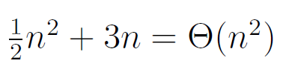

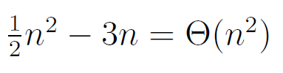
Task 2 : Prove that

